Slide 1
DATA CURATION AND MANAGEMENT (DMA820S) GROUP ASSIGNMENT
GROUP FIVE (5)

Slide 2
GROUP MEMBERS
NAMES | REGISTRATION NUMBERS
OBED BORTEY BORTIER | SE/DMD/24/0009
FRANCIS AHETO | SE/DMD/24/0016
TRACY ABENA BENNEH | SE/DMD/24/0018
EDITH OBENEWAA | SE/DMD/24/0025

Slide 3
QUESTION
GitHub repositories are now vital tools for collaborative and reproducible research. Identify five data-driven organizations or research institutions that use GitHub and analyze how they structure and manage their repositories. Your presentation should highlight key practices such as naming conventions, documentation, modular design, and use of GitHub features.

Slide 4
OUTLINE
Organizations Studied:
World Bank Group
World Health Organization (WHO)
National Aeronautics and Space Administration(NASA)
European Council for Nuclear Research.(CERN)
New York Times (NYT)
Key Practices Observed:
Naming Conventions – Clear, concise, and descriptive (often lowercase, hyphenated, or acronym-based).
Documentation – Detailed README, setup guides, FAQs, licensing info.
Modular Design – Separate folders/modules for data, scripts, outputs, and docs.
GitHub Features – Use of Issues, Pull Requests, GitHub Actions, Wikis, Labels, Milestones, and Branch Protections.

Slide 5
INTRODUCTION
GitHub is a platform largely used in software development which offers a robust framework for documenting all activities of research projects. Organizations use GitHub because it provides a centralized platform where they can easily manage and share codes across different teams while keeping track of changes and progress.

Slide 6
INTRODUCTION CONT’D
The following are five data-driven organizations or research institutions that use GitHub;
World Bank Group
World Health Organization (WHO)
National Aeronautics and Space Administration (NASA)
European Organization For Nuclear Research (CERN)
New York Times (NYT)

Slide 7


1. WORLD BANK GROUP (WBG)
The World Bank Group (WBG) is a global partnership made up of five international institutions working together to reduce poverty and promote sustainable development with their headquarters located at Washington, D.C. in the United State of America. They support countries through financial assistance, policy advice, and knowledge sharing.

Slide 8
WORLD BANK GROUP CONT’D
One of World Bank strengths lies in its ability to collect, analyze, and share large volumes of development data, which it uses to guide decision-making and measure progress.
Their work spans various sectors, including education, healthcare, infrastructure, and environmental sustainability.

Slide 9
Some examples of World Bank Group repositories
Global Learning Assessment Database (GLAD) which is a World Bank initiative that brings together and harmonizes student learning assessment data from different countries.
Global Labor Database (GLD) which is a World Bank-led project that harmonizes labour force survey data from many countries.
DECAT_Space2Stats which is a program designed to provide easy access to geospatial data for academics, statisticians and data scientists.

Slide 10
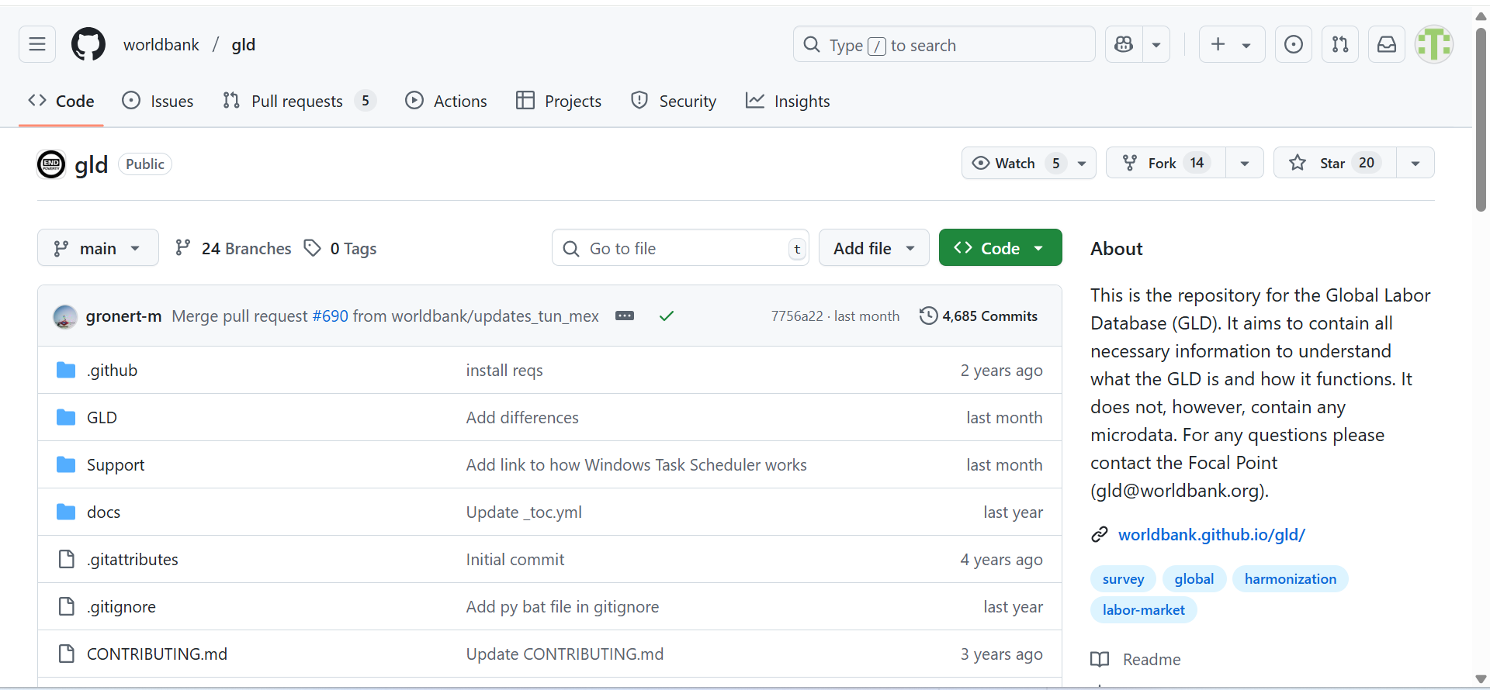
WORLD BANK/GLD REPOSITORY

Slide 11
Naming Convention
The World Bank Group follows a descriptive and concise naming for its repositories which makes it easy for users to remember, and also make it look professional. The World Bank uses a mix of naming style for its repositories including lower- and upper-case alphabetic characters, hyphen, underscore, abbreviations or acronyms to represent the project name. This consistency makes it easier for users to quickly recognise the focus and intended use of each repository.

Slide 12
Naming Convention Cont’d
For example, repositories such as “glad” (Global Learning Assessment Database) and “gld” (Global Labor Database) use short and recognisable acronyms which are informative and match the with the topic, welfare-weather-app, SPI, DECAT_Space2Stats, these shows the variation in their naming convention.

Slide 13
Documentation
Good documentation is like a user’s map which tells people where they are, what’s around, and how to get where they need to go. In World Bank repositories, documentation often includes a clear README at the root level, outlining the project’s purpose, how to set it up, and how to contribute.
Larger projects have dedicated folders like “docs” with detailed guides, FAQs, and examples. The goal is to make it easy for anyone to quickly understand the project and start using it without feeling lost. It contains license information to clarify how the data or code can be reused.

Slide 14
Modular Design
A modular approach keeps projects tidy and easier to maintain, especially when multiple teams or contributors are involved. Instead of cramming all functionality into one giant, tangled codebase, related features are grouped into separate and well-defined modules.
For example, the Pacific Observatory repository which is a program that finds new way to gather information when official statistics are missing. Instead of mixing everything together in there, the project is neatly organized into distinct folders like; “data” for raw inputs, “scripts” for processing routines, “notebooks” for exploratory analysis, “outputs” for final tables and visuals, and “docs” for methodology and guideposts.

Slide 15
Use of GitHub Features
GitHub is more than just a storage space, it’s a toolbox for collaboration. World Bank repositories often use;
Issues to track bugs, feature requests, and ongoing discussions.
Pull Requests to review and merge code changes.
GitHub Actions to automate testing, deployment, or data updates.
Wikis to provide detailed project documentation.
Projects to track tasks and progress.
Labels, milestones, and branch protections ensure that work moves smoothly and that everyone stays aligned no matter how big the team or the dataset.

Slide 16

2. WORLD HEALTH ORGANIZATION
The World Health Organization (WHO) is a specialized agency of the United Nations responsible for international public health, with its headquarters in Geneva, Switzerland.
Its mission is to promote health, keep the world safe, and serve the vulnerable by coordinating global health responses, setting evidence-based health standards, and providing technical assistance to member states.
In recent years, WHO has increasingly adopted open-source platforms like GitHub to share datasets, analytical tools, modelling code, and digital health guidelines for researchers, policymakers, and the public.

Slide 17
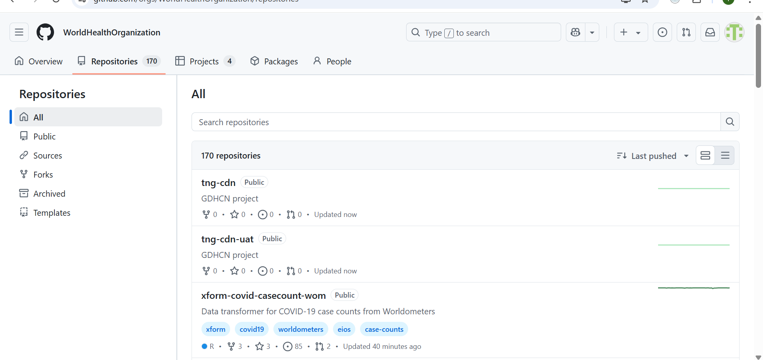
WHO REPOSITORIES

Slide 18
Example of WHO repositories
Godata: this hosts outbreak investigation tool, supporting features like contact tracing and transmission chain visualization. It’s a hub linking multiple sub-repos: API, front-end, mobile app, installers, and more.
smart-core: this is a FHIR-based Core Implementation Guide that defines shared data elements like (antenatal care), complete with an automated build system that publishes documentation.

Slide 19
Naming Convention
World Health Organization uses clear, descriptive naming conventions to make repositories easily identifiable and professional. Names often reflect the project’s focus, target health topic, or acronym of a well-known WHO initiative. They may include lowercase letters separated by hyphen, underscore, or direct acronyms.
Examples include; world-health-org-metrics, national-malaria-data-repository, smart-trust-phw, anthroplus, smart-hiv. These names are concise and help users to quickly understand the repository’s purpose.

Slide 20
Documentation
Most repositories include a README.md at the root level explaining the project’s objective, data sources, installation steps, and usage instructions.
WHO also provides licensing details, usually adopting open licenses to allow free use of code and data while ensuring proper attribution.
Larger initiatives often have a docs directory containing extended manuals, FAQs, and case studies.
This structured documentation makes WHO repositories accessible to both technical and non-technical users.

Slide 21
Modular Design
WHO applies a modular design approach to keep projects organized and maintainable. Related functions are separated into dedicated modules or directories such as data for raw and cleaned datasets, scripts for data processing, analysis for statistical models, and outputs for visualizations and reports.
For example, the Go.Data repository is split into separate repositories for the backend API, the user interface, and the mobile app. This way developers can update the mobile app without affecting the backend, making the whole system easier to maintain and improve.

Slide 22
Use of GitHub Features
Issues are used to log bugs, suggest improvements, and discuss methodological updates.
1
Pull Requests enable peer review of code before integration, ensuring quality and consistency.
2
Wikis provide extended project documentation and training materials.
3
GitHub Actions automate workflows such as data refreshes, model recalibration, and deployment of dashboards.
4

Slide 23

3. NATIONAL AERONAUTICS AND SPACE ADMINISTRATION (NASA)
NASA is one of the world’s leading scientific and data-driven organizations, dedicated to space exploration, earth observation, and advanced research. Its mission is to explore the unknown in air and space, innovates for the benefit of humanity, and inspires the world through discovery. It manages a wide range of open-source projects to promote transparency, collaboration. Examples of NASA repos are;
EMIT-Data-Resources is a project that provides guides, tutorials, and scripts to help users work with data from the Earth Surface Mineral Dust Source Investigation (EMIT) mission.
NASA-3D-Resources is a repository that serves as a public library of 3D models, textures, and images collected across NASA’s centres.

Slide 24
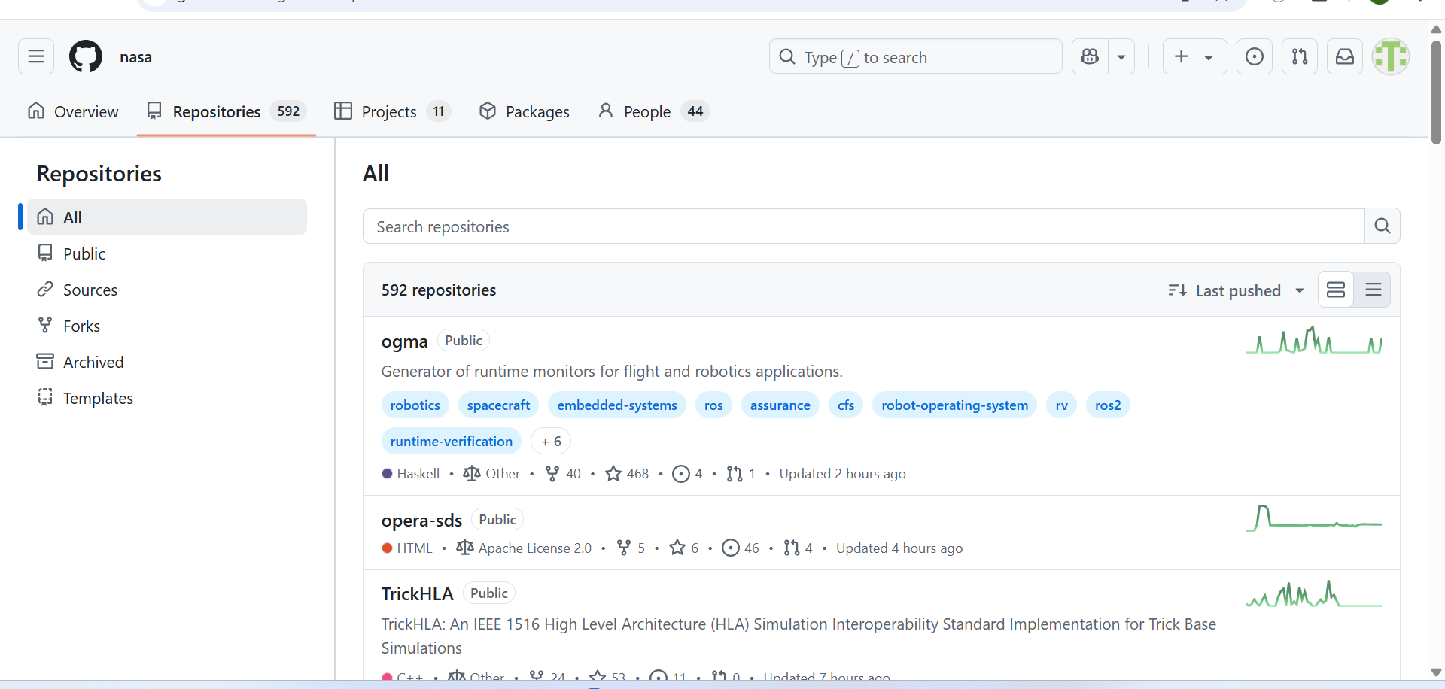
NASA REPOSITORIES

Slide 25
Naming Convention
NASA’s repositories follow clear, descriptive, and functional naming patterns that indicates the specific project and make them easy to find and understand. NASA mixes it naming convention and often uses abbreviations or acronyms. These names avoid vague labels and instead use real words or short acronyms so the purpose is obvious from the repo name. Some examples include;
Openmct which stands for Open Mission Control Technologies (mission-control framework).
EMIT-Data-Resources is clearly labelled as data resources for the EMIT mission.

Slide 26
Documentation
README which explain the project’s purpose, quick install or run steps, and common use cases (so a newcomer can get started).
Many repos include CONTRIBUTING.md file which provides guidelines for how others can contribute to the project, and CODE_OF_CONDUCT.md file which set rules for respectful collaboration.
Data-resource repos (e.g., EMIT-Data-Resources) often contain Jupyter notebooks so researchers can reproduce analyses.

Slide 27
Modular design
NASA splits big projects into small, independent modules with each doing one job well, like data processing or visualization. This makes updates easier, errors reduced, and parts be reused for new missions.
The NPSS-Power-System-Library, for instance houses components such as resistors, capacitors, and electric machines within separate folders. Engineers can tweak a part of the power system, like the model configuration without touching the rest.

Slide 28
Use of GitHub features
NASA uses GitHub’s collaboration and CI features to run open projects well:
Issues: public issue trackers let users report bugs or request features and maintainers respond and triage.
Pull requests and code review: every change goes through pull requests so code is reviewed before merging (common in active repos).
Actions / Continuous Integration: these are used to automatically test and validate code whenever changes are made.

Slide 29

4. EUROPEAN ORGANIZATION FOR NUCLEAR RESEARCH (CERN)
The European Organization for Nuclear Research (CERN) is one of the world’s largest and most complex centres for scientific research. It conducts high-energy physics experiments, such as those at the Large Hadron Collider (LHC), and collaborates with thousands of scientists and engineers worldwide.
To manage the scale and complexity of these projects, CERN employs a robust GitHub repository management strategy. Some examples of CERN repositories are; TIGRE, OpenPHIGS and CAiMIRA.

Slide 30
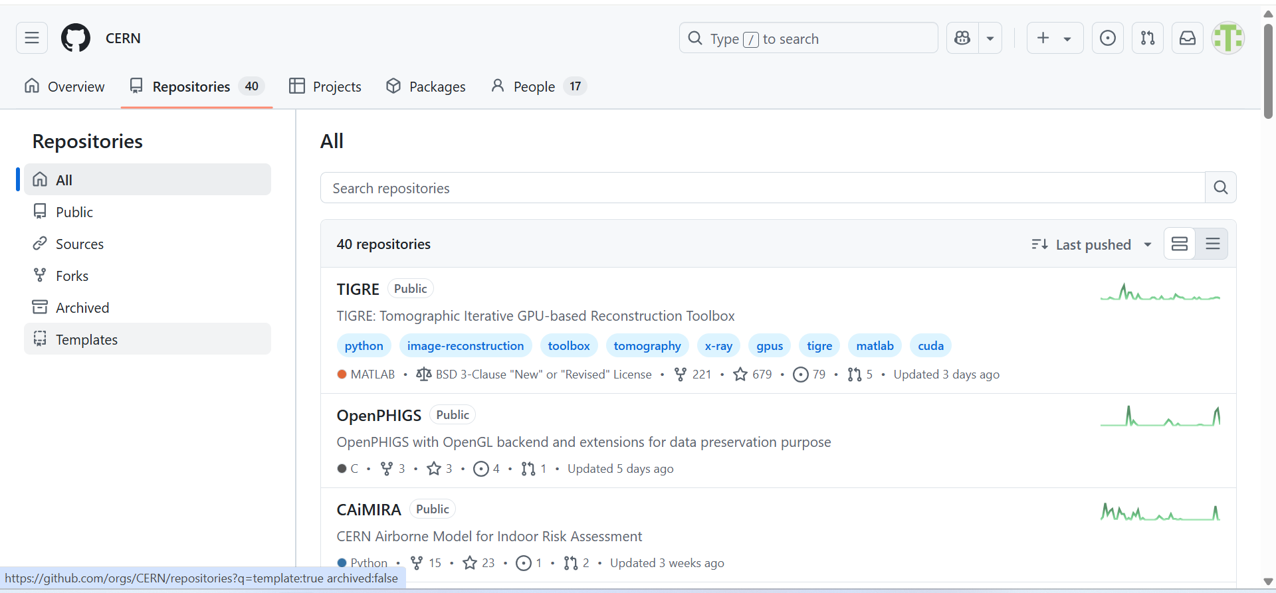
CERN REPOSITORIES

Slide 31
Naming Convention
CERN structures its repositories by naming them according to the specific experiment or component they serve. This naming convention ensures clarity, as each repo is immediately identifiable by its function.
For example, repositories are named after major experiments like 'ATLAS', 'CMS', or 'ALICE', with additional descriptors for subprojects, such as 'atlas-data-processing' or 'cms-detector-control'. This approach supports quick navigation and minimizes confusion in large, multi-team environments.

Slide 32
Documentation
Each repository includes clear README files, setup instructions, and code examples to help developers, researchers, and collaborators to get started quickly. For example; the ROOT repository provides libraries and tools for data processing, statistical analysis, and visualization which is essential for handling the massive datasets produced at CERN.
Security is particularly critical due to the sensitivity of experimental data and the need to protect systems from cyber threats. CERN often publishes internal developer handbooks and uses automated code analysis tools to ensure compliance with these standards.

Slide 33
Modular design
Given the scale of CERN’s experiments, systems are broken into modular subsystems, each with its own dedicated repository. This modular approach allows specialized teams to work independently on components such as detector electronics, data acquisition systems, simulation software, or analysis pipelines.
Example; the TIGRE (GPU-based image reconstruction toolkit) repository has one module which handles image input/output, another which handles mathematical reconstruction algorithms and another which deals with GPU acceleration.

Slide 34

Use of GitHub features
Issues: it tracks bugs, feature requests, and improvement ideas. For example, a physicist detecting a visualization error in the ROOT library can open an issue, attach screenshots, and tag developers.
Pull Requests: they enable code review and collaborative development. A contributor can fork the Geant4 repository, make performance optimizations, and submit a pull request for review by CERN maintainers.
Releases: they distribute stable versions of software with release notes. Researchers can download tested builds of data analysis frameworks without pulling experimental code.

Slide 35

5. NEW YORK TIMES (NYT)
The New York Times, one of the world's leading news organizations, publishes numerous open-source software projects and data-driven tools on GitHub. Their public repositories include everything from interactive newsroom tools and data visualizations to collaborative documentation platforms, making it easier for journalists, developers, and data scientists to use, reuse, and build upon their work.

Slide 36
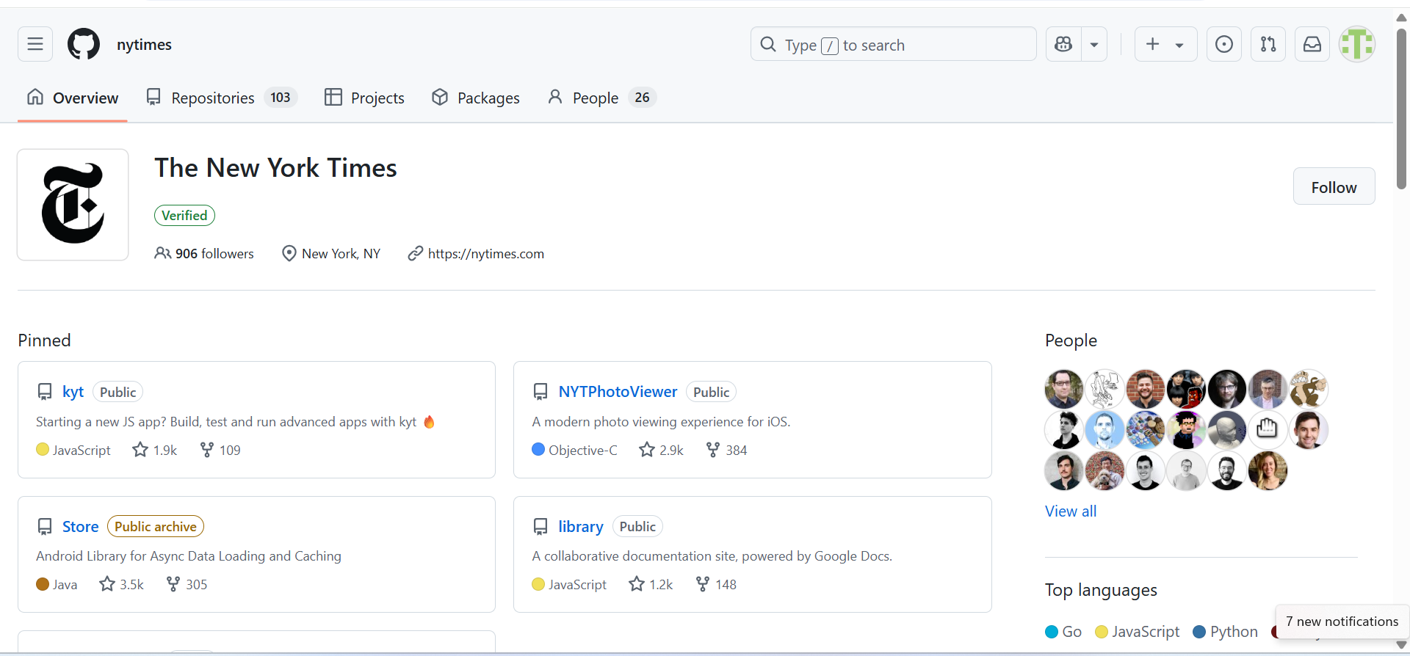
NEW YORK TIMES REPOSITORIES

Slide 37
Naming convention
New York Times repositories use lowercase, hyphenated names that describe purpose of the project. It makes the names readable in URLs and consistent across hundreds of repos. These semantic names improve discoverability, scripting or automation, and mental mapping. Some examples of NYT repositories are; covid-19-data, drone-gke, aframe-loader-3dtiles-component.

Slide 38
Documentation
NYT repositories often include a README.md file explaining the purpose of the project, how to install it, and example usage. Example; The NYT Cooking API repo has clear setup instructions, an API usage guide, and licensing info in the README so developers can quickly integrate recipe data into apps.

Slide 39
Modular design
NYT splits code into focused libraries and tools (e.g., kyt as a JS app toolkit, drone-gke as a deployment plugin, datasets in their own repos).
READMEs (e.g., newsdev/about-int) describe team responsibilities separate from code. This enables reuse, independent release cycles, and clear ownership.
For example; the Library Components repo has separate modules for rendering charts, processing text, and handling user interactions with each stored in its own folder, making it easy to update or reuse without affecting other parts.

Slide 40
Use of GitHub Features
Issues: Used for bug tracking and feature requests, allowing contributors to discuss improvements before coding.
Pull Requests: Developers submit code changes which are reviewed before merging, ensuring quality.
Branches: NYT uses feature branches (e.g., feature/chart-updates) to test changes without breaking the main code.
Actions: Automated testing runs on every pull request to catch errors early.

Slide 41
CONCLUSION
These organizations use GitHub to manage and share their projects. They organize repositories using clear naming conventions and detailed documentation, break projects into modular parts for easier updates, and use GitHub features like issues, pull requests, and automated testing to collaborate effectively. These approach help them maintain quality, improve teamwork, and support reproducible research worldwide.

Slide 42
REFERENCES
Chen, K. Y., Toro-Moreno, M., & Subramaniam, A. R. (2025). GitHub enables collaborative and reproducible laboratory research. PLoS biology, 23(2), e3003029. https://doi.org/10.1371/journal.pbio.3003029
Decan, A., Mens, T., Mazrae, P. R., & Golzadeh, M. (2022). On the Use of GitHub Actions in Software Development Repositories. IEEE International Conference on Software Maintenance and Evolution, 235–245. https://doi.org/10.1109/ICSME55016.2022.00029
Haddad, I. (2023). Recommended Practices for Hosting and Managing Open Source Projects on GitHub. https://doi.org/10.70828/zfwq4969
Idiegbeyan-Ose, J., Ifijeh, G., Iwu-James, J., & Ilogho, J. E. (2016). Management of Institutional Repositories (IR) in Developing Countries (pp. 306–331). IGI Global. https://doi.org/10.4018/978-1-5225-0474-0.CH016

Slide 43
APPENDIX
WORLD BANK: https://github.com/worldbank
WORLD HEALTH ORGANIZATION: https://github.com/WorldHealthOrganization
NASA: https://github.com/nasa
CERN: https://github.com/CERN
NEW YORK TIMES: https://github.com/nytimes

Slide 44

Thank You!!!

